Slide 1

Spotify Tracks Dataset Analysis
Presenters:
Achintya
Shravan Doda
Vrushali Khatane

Slide 2
Table of contents
01
02
03
04
05
06
07
08
09
Introduction
Project Scope
Dataset Overview
Statistical Statistics
Inferential Analysis
Hypothesis Testing
Regression Analysis
Lasso Regression
Support Vector Regression

Slide 3
Introduction
Platforms like Spotify have revolutionized music access, making it easy for users to discover and enjoy songs anytime, anywhere.
The vast amount of data generated by Spotify offers valuable opportunities to uncover patterns in music consumption and understand what makes tracks popular.
The project uses a pre-processed subset of the Spotify Tracks dataset to explore key factors influencing track popularity.
The analysis focuses on six key features:
Popularity (target variable).
Valence (happiness level of the track).
Loudness (perceived intensity).
Acousticness (degree of acoustic sounds).
Explicit Content (whether a track is marked explicit).
Genre (categorical classification of the track).

Slide 4
Project Scope
Main Objective
To predict the popularity of a Spotify track based on its musical characteristics and metadata.
Specific Goals
Descriptive Analysis:
Summarize and visualize the dataset to understand its structure and key trends.
Investigate distributions of numerical features (e.g., valence, loudness, acousticness).
Highlight differences in categorical features (e.g., genre and explicit content).
Inferential Analysis:
Analyze relationships between variables:
Example: How does loudness affect popularity?
Use hypothesis testing to validate insights.
Predictive Modeling:
Build regression models to predict popularity using the selected features.
Evaluate model performance to identify the most effective approach.

Slide 5
Dataset Description
Source: Kaggle’s Spotify Tracks dataset, containing data for over 90,000 unique tracks across more than 100 genres.
Purpose: Extract meaningful insights by analyzing a manageable subset of the data.
Preprocessing:
Focused on 10 most popular genres to ensure analysis feasibility.
Selected 6 key features to maintain relevance and simplicity.
Filtered Dataset Stats
Track Count: 7,279 tracks.
Explicit Content Distribution:
6,723 non-explicit tracks.
556 explicit tracks.
Genre Distribution:
Top genres include Indian, Jazz, Pop, Hip-hop, etc.
Relatively balanced across genres.

Slide 6
Methods Overview
Descriptive Analysis:
Summarize numerical features (mean, median, variance).
Visualize distributions using histograms, KDE plots, and box plots.
Analyze categorical features using bar charts and contingency tables.
Inferential Analysis:
Use scatter plots and correlation heatmaps to explore relationships.
Perform hypothesis tests:
Kruskal-Wallis Test: Test whether popularity differs across genres.
Mann-Whitney Test: Compare popularity of explicit vs. non-explicit tracks.
Chi-Square Test: Examine the dependency between genre and explicitness.

Slide 7
Methods Overview
Predictive Modeling:
Implement regression models:
Multiple Linear Regression.
Lasso Regression.
Support Vector Regression (SVR).
Evaluate models using:
R² (Coefficient of Determination): Measures goodness of fit.
Mean Squared Error (MSE): Evaluates prediction error.

Slide 8
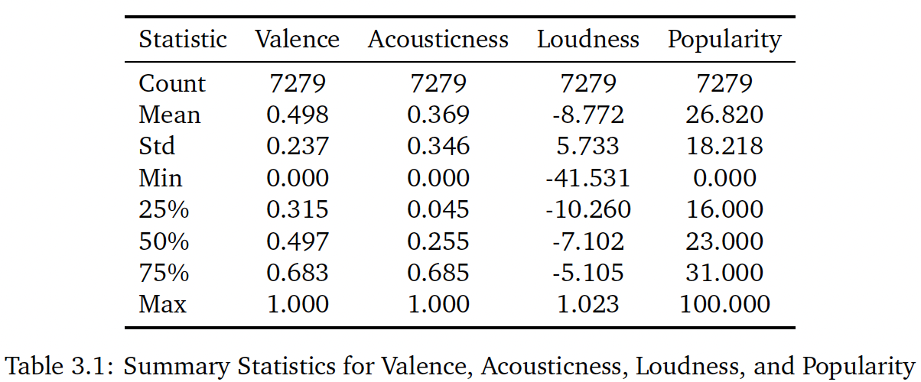
Descriptive Analysis
Valence and Acousticness are bounded within the range [0, 1], with mean values of 0.498 and 0.369, respectively.
Popularity spans a broader range of [0, 100], with a mean of 26.82.
Loudness exhibits a mean value of −8.772.

Slide 9
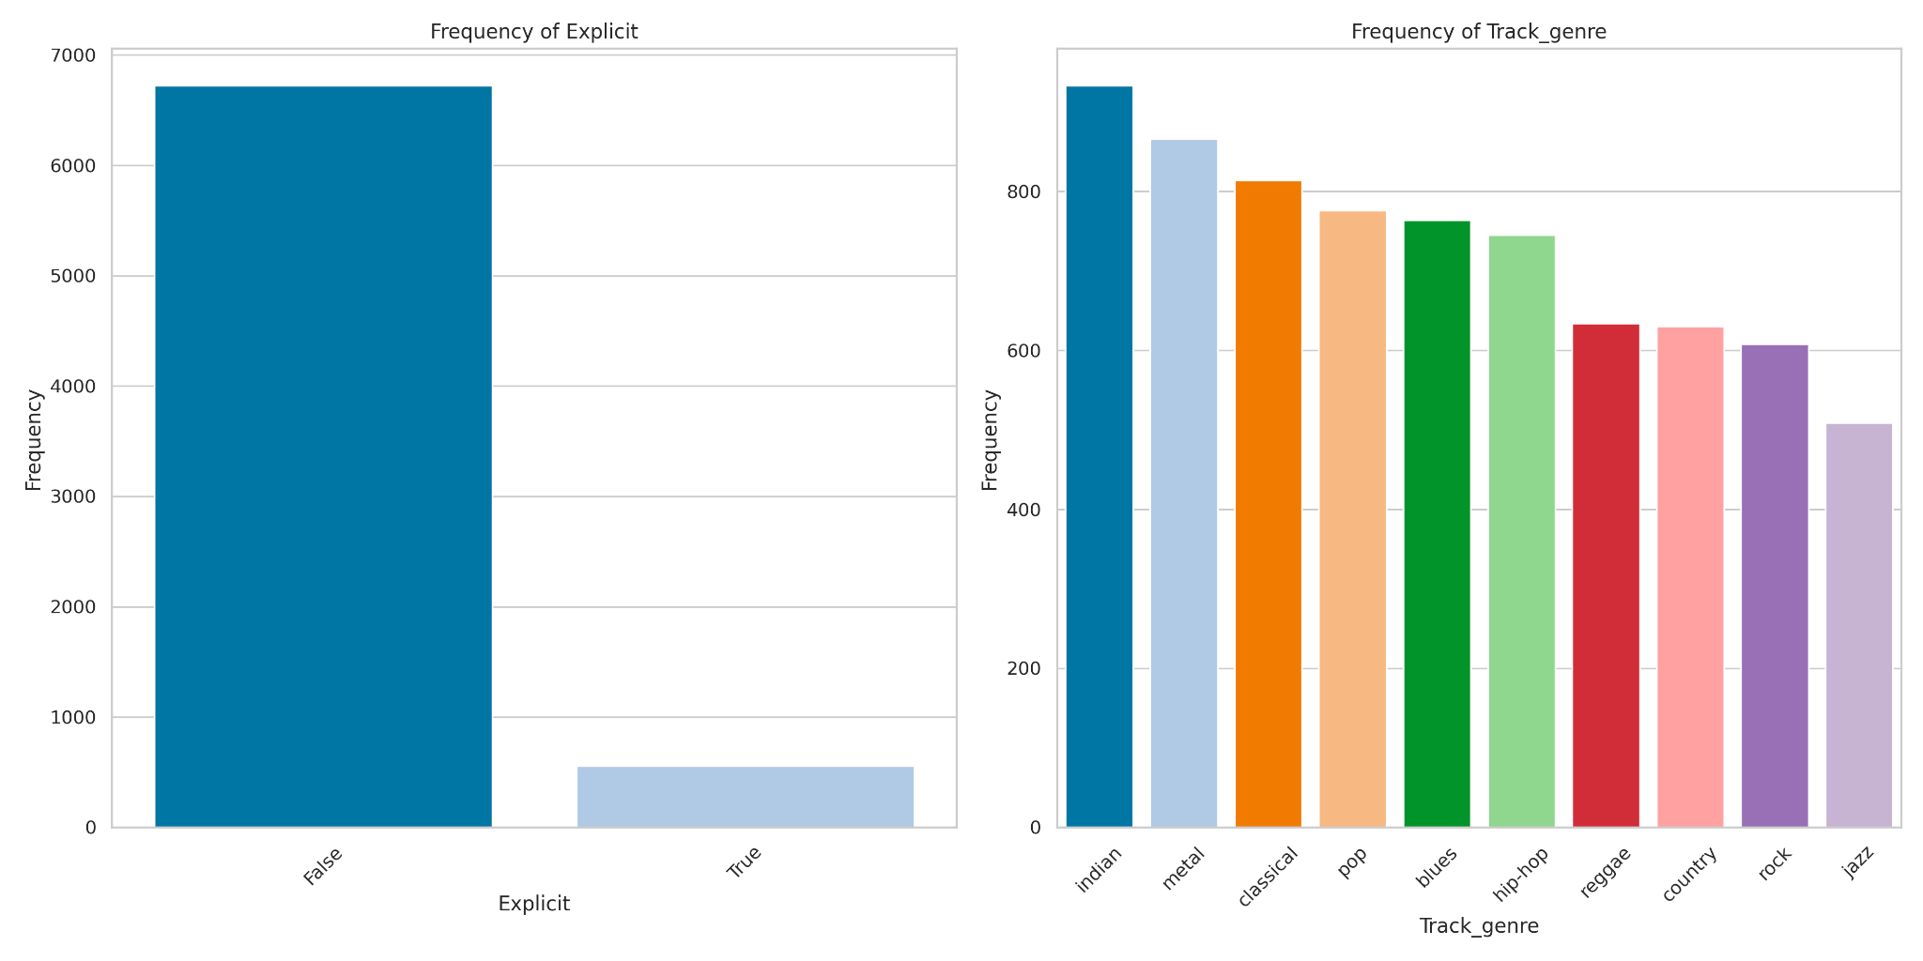
Categorical Features
Categorical Features summarizes the distribution of tracks across different genres.
The distribution appears relatively balanced, with no single genre dominating the dataset.
The indian genre contains the highest number of tracks, while the jazz genre has the fewest.
The dataset includes 6, 723 non-explicit tracks compared to only 553 explicit tracks.

Slide 10
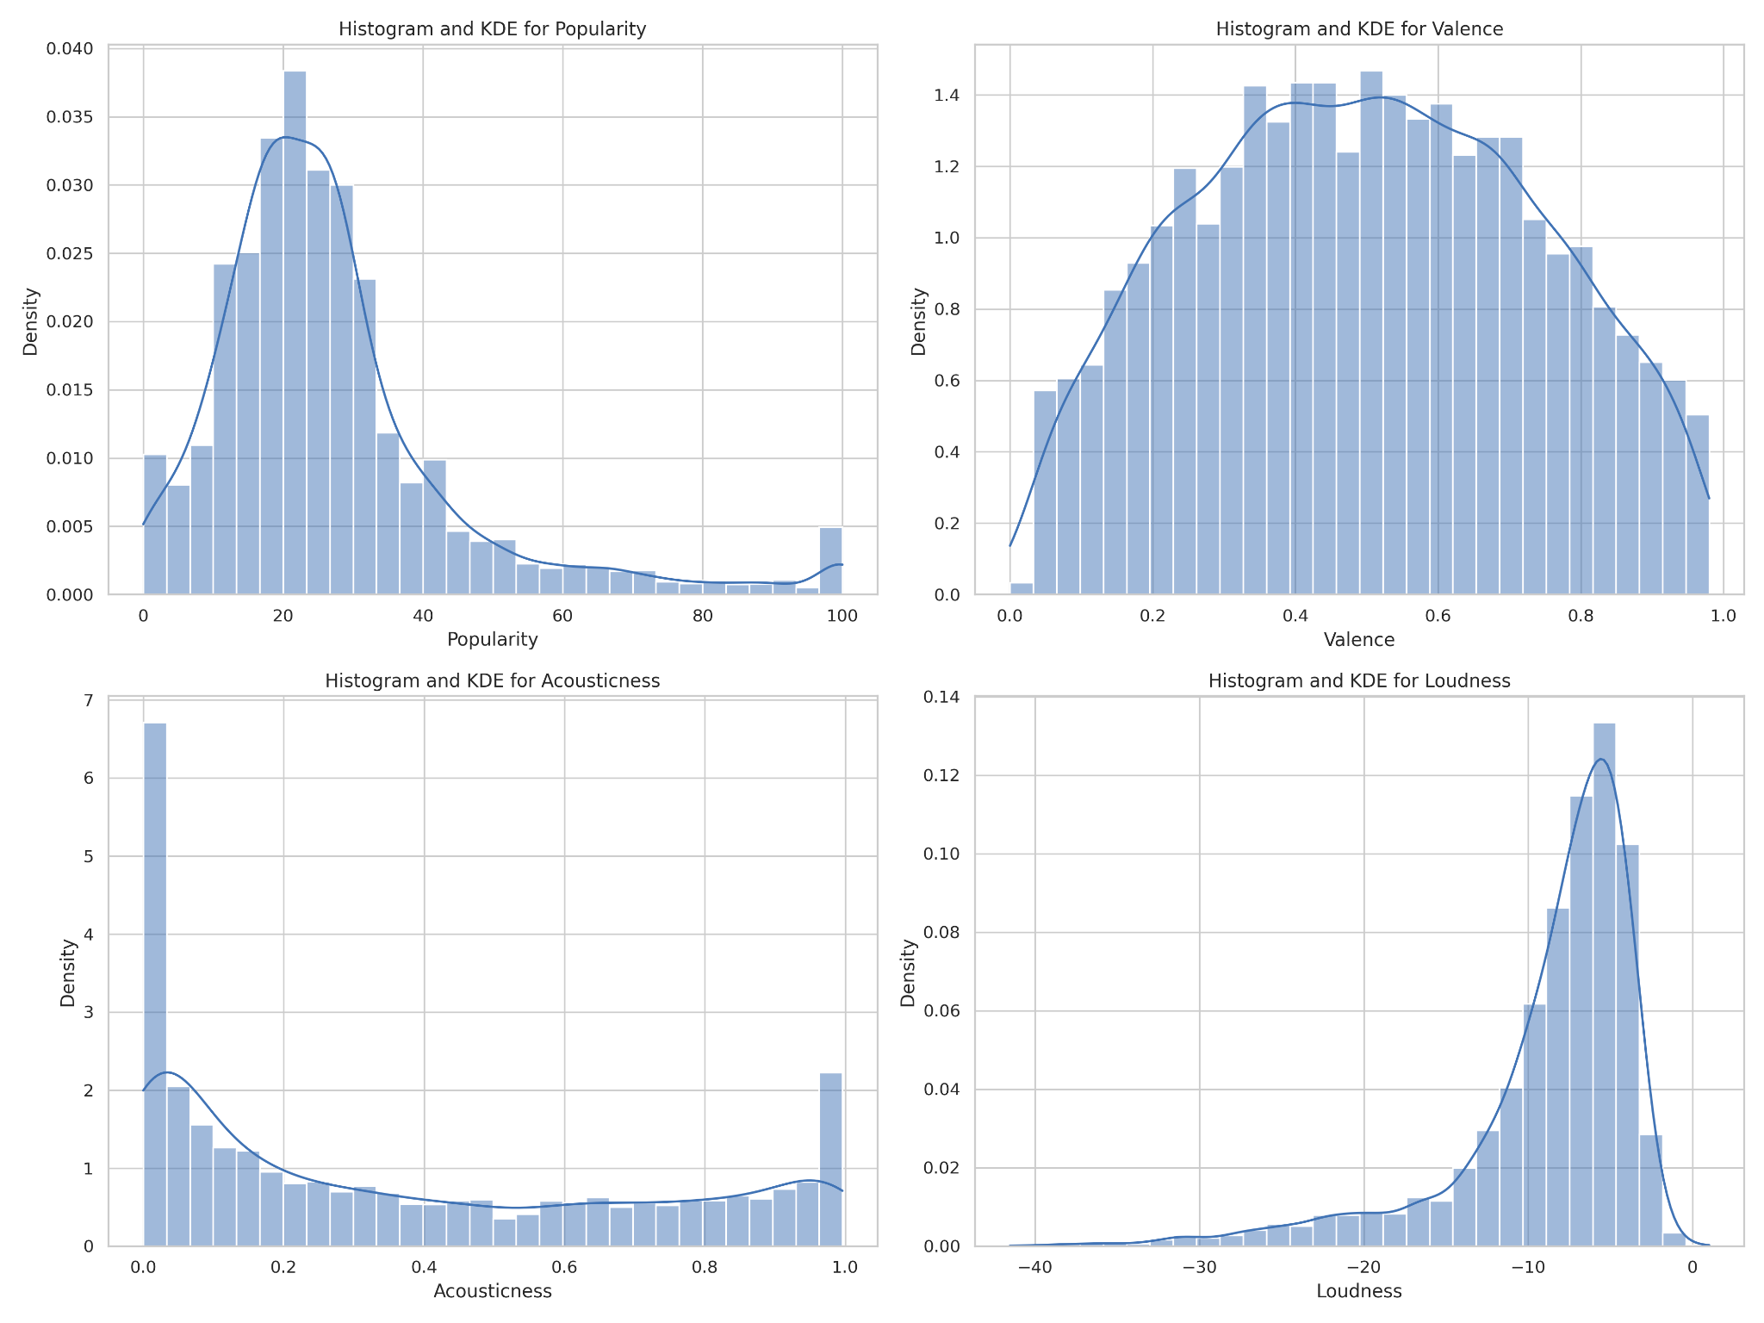
Visualizing Distributions
Popularity:
Observation: Right-skewed with most tracks scoring between 20 and 30.
Very few tracks are highly popular (above 80).
Valence:
Observation: Uniformly distributed across the range.
Indicates that tracks span the full spectrum of "happiness" evenly.
Loudness:
Observation: Left-skewed with peaks around -8 to -10 dB.
Outliers exist at very low loudness levels (below -40 dB).
Acousticness:
Observation: Concentrated near zero, showing most tracks are less acoustic.
Small proportion of tracks with high acoustic values (close to 1).

Slide 11
Outliers and Skewness
Outliers
Popularity: High-end outliers (scores near 100), representing disproportionately popular tracks.
Loudness: Low-end outliers (below -40 dB), indicating extremely quiet tracks.
Acousticness & Valence: No significant outliers.
Skewness
Right-Skewed: Popularity with long tail at high values, clustered around ~26.8.
Left-Skewed: Loudness shifted to low dB; Acousticness peaks near zero.
Impact on Analysis
Outliers: Distort regression coefficients, risk overfitting.
Skewness: Challenges normality assumptions in parametric tests.

Slide 12
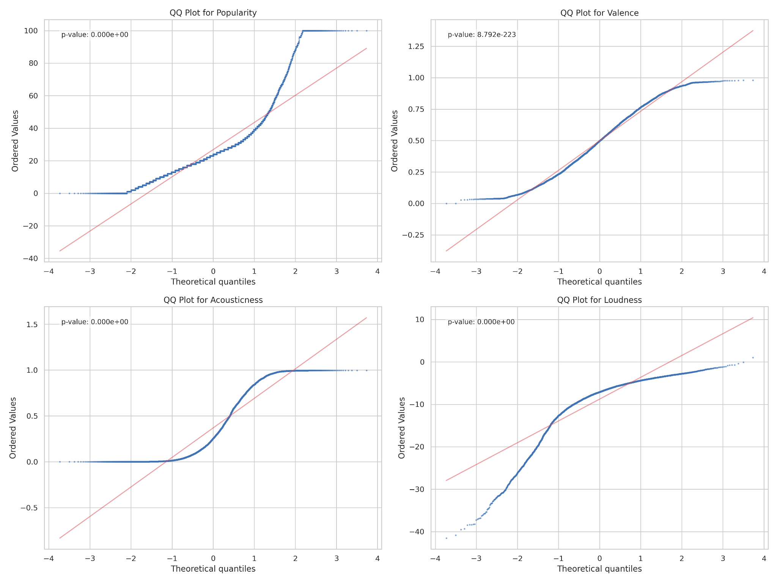
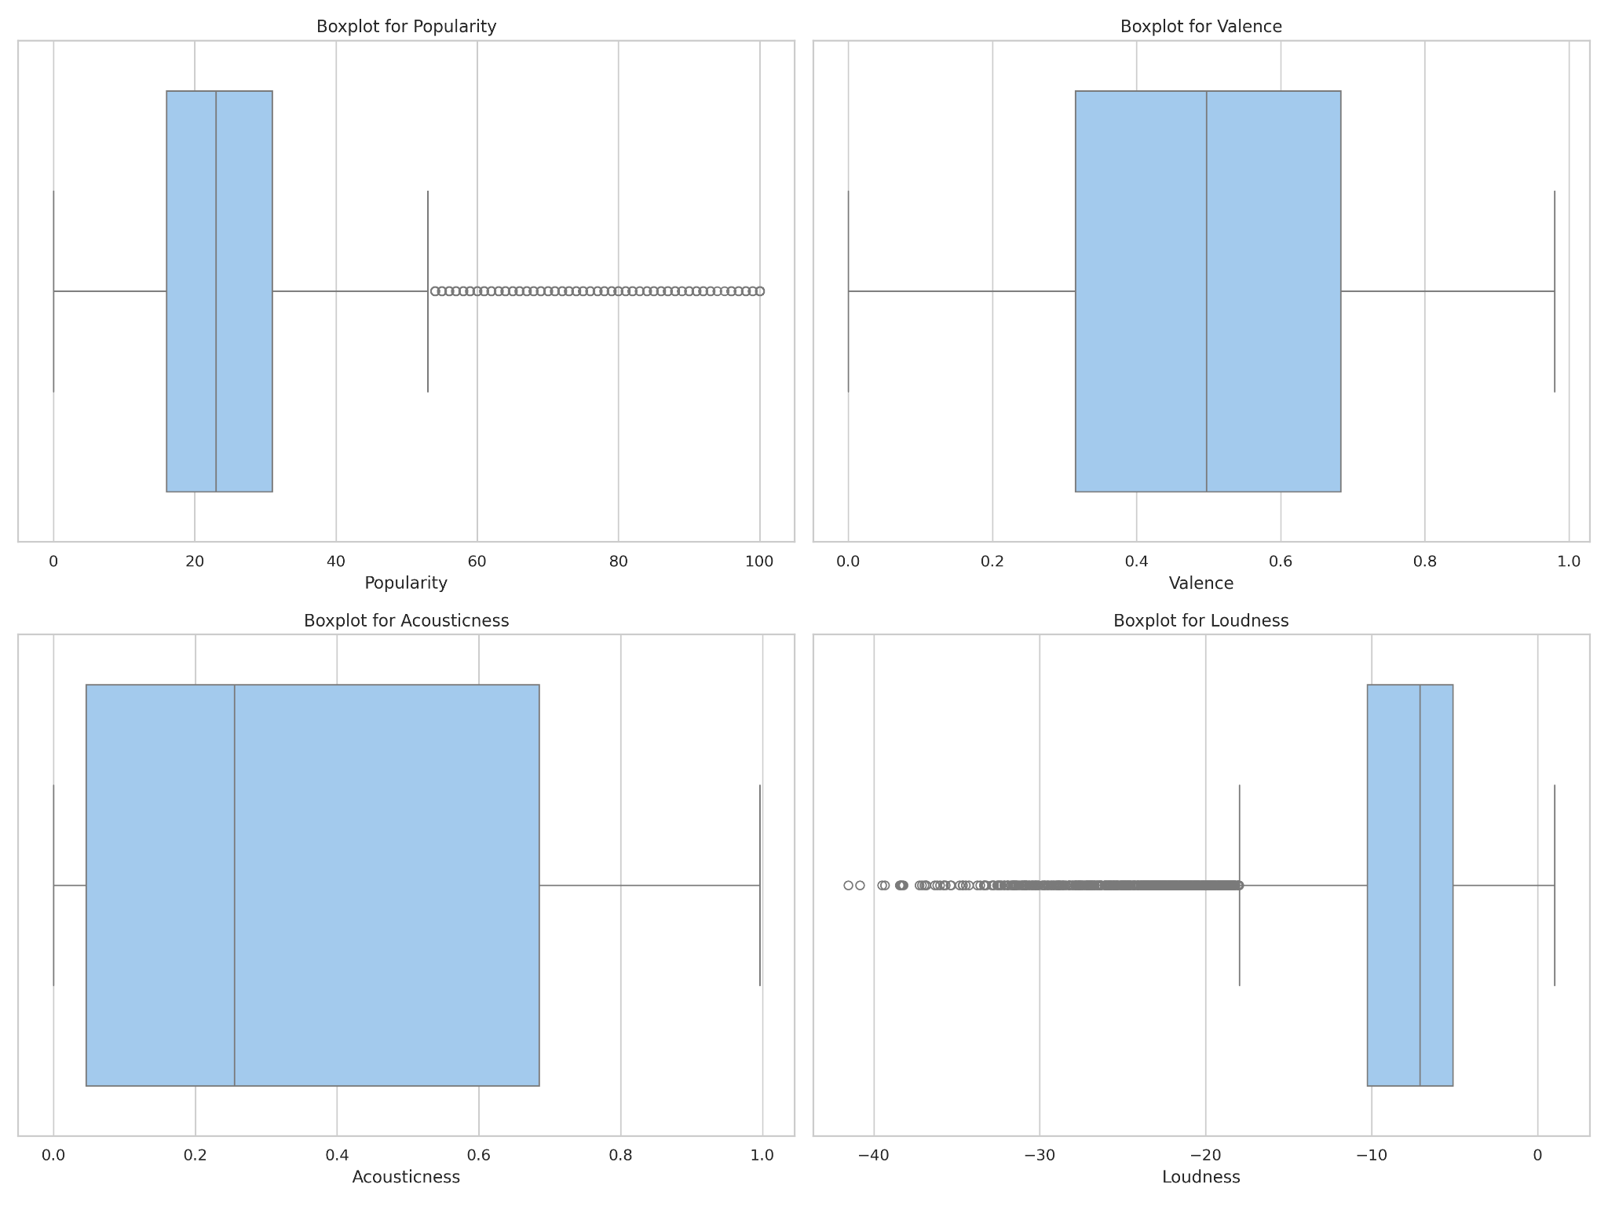

Slide 13
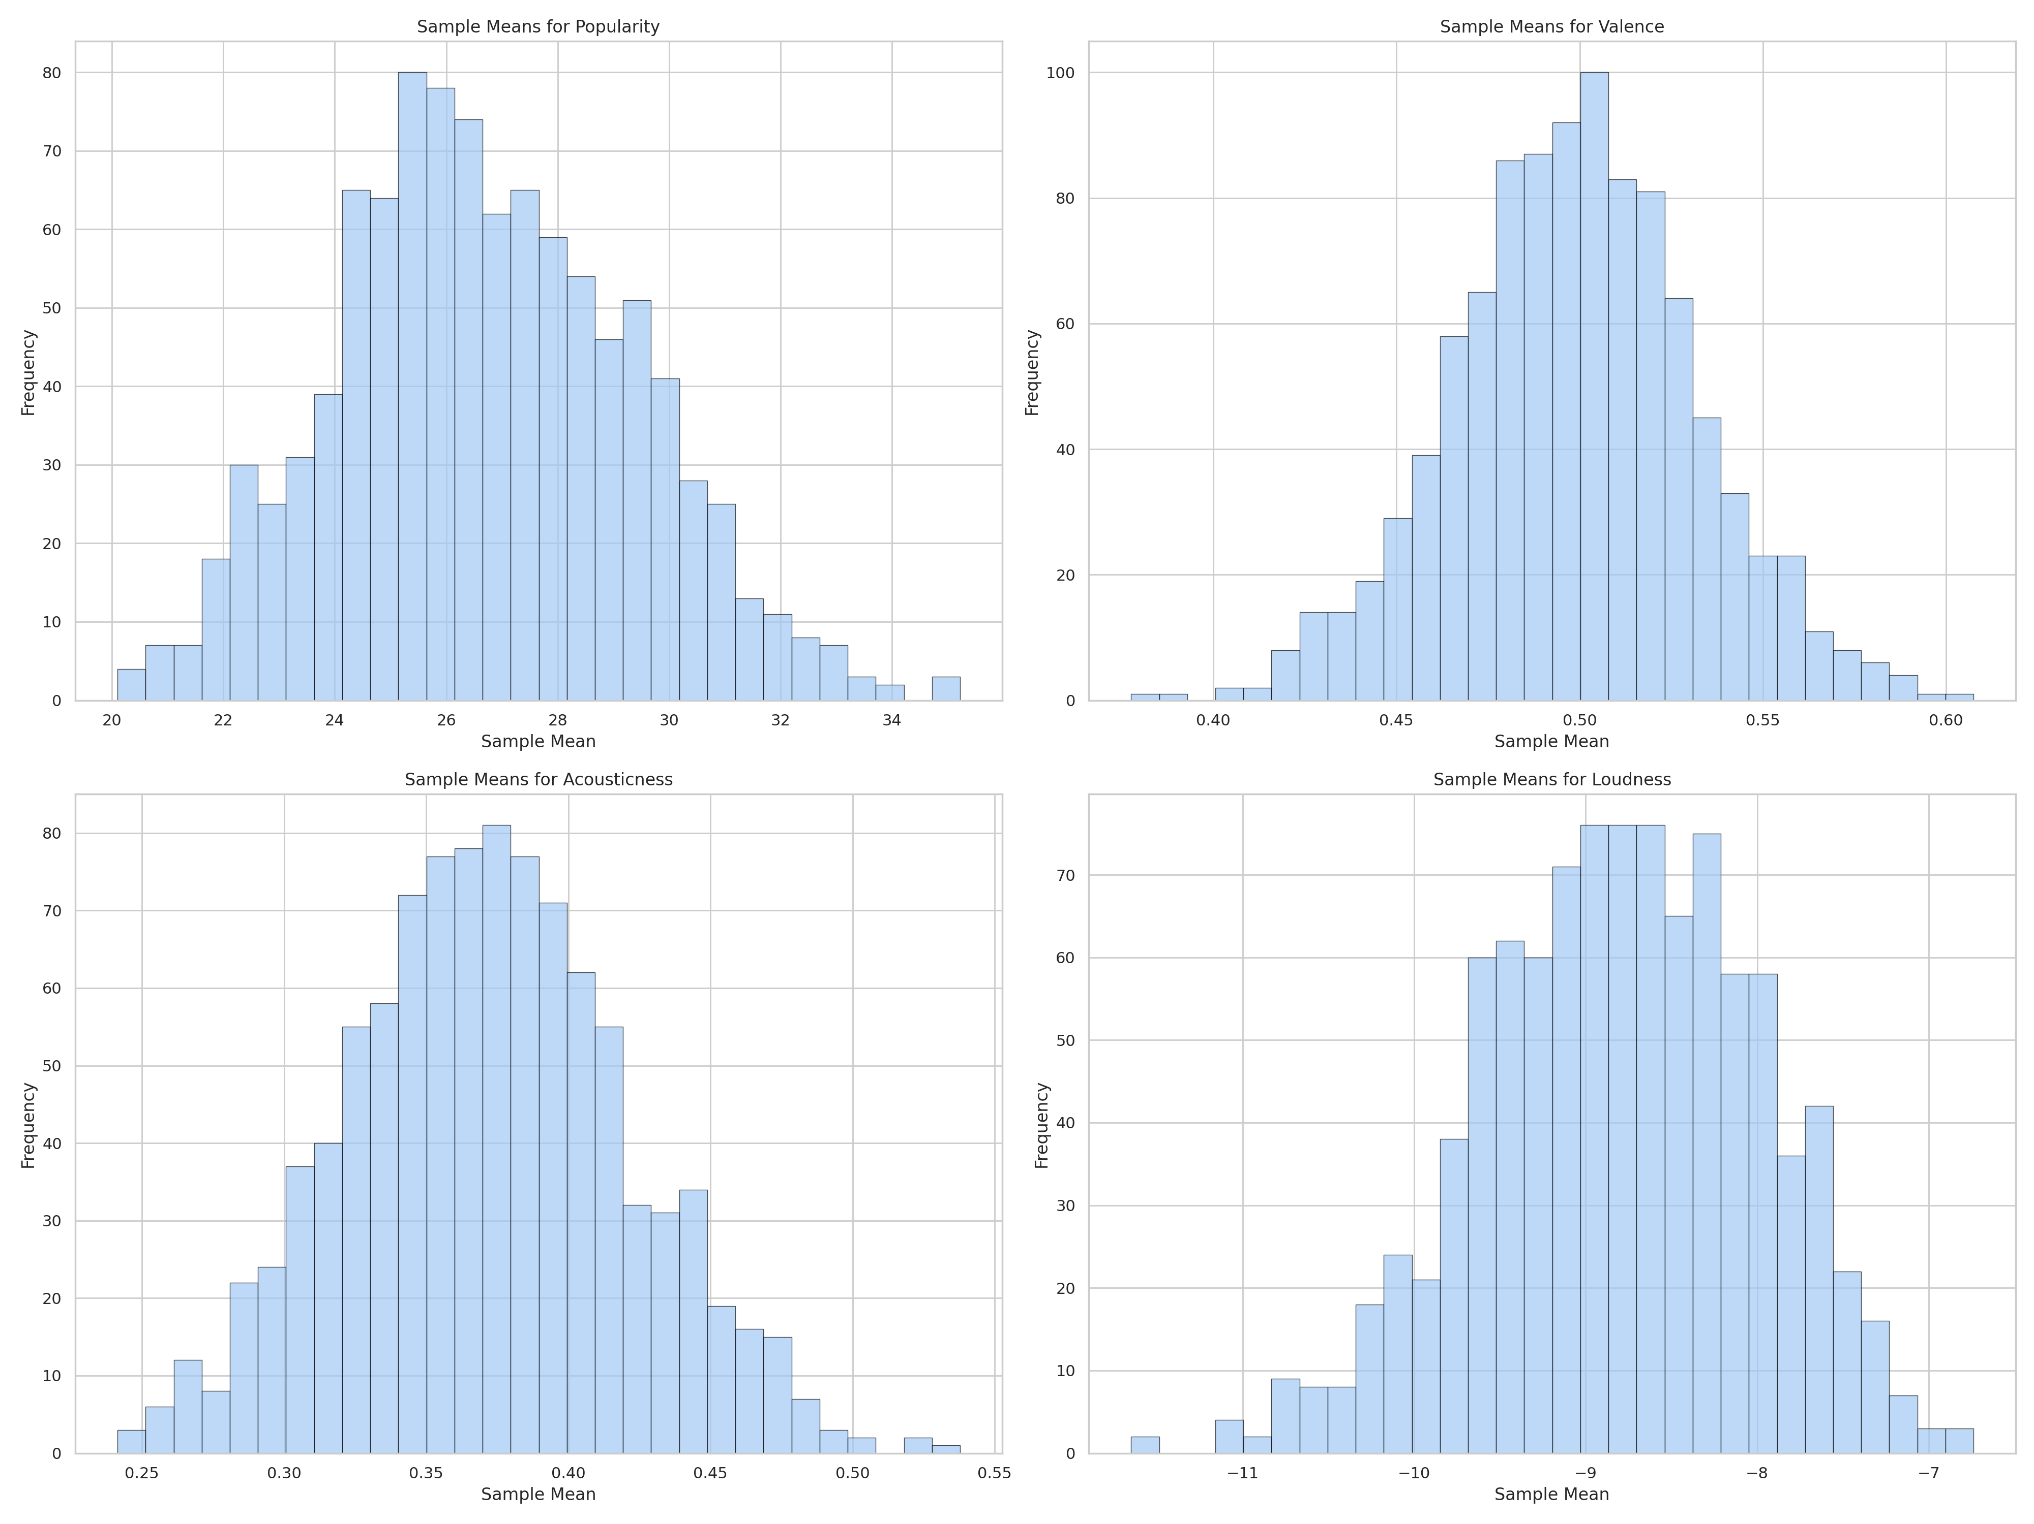
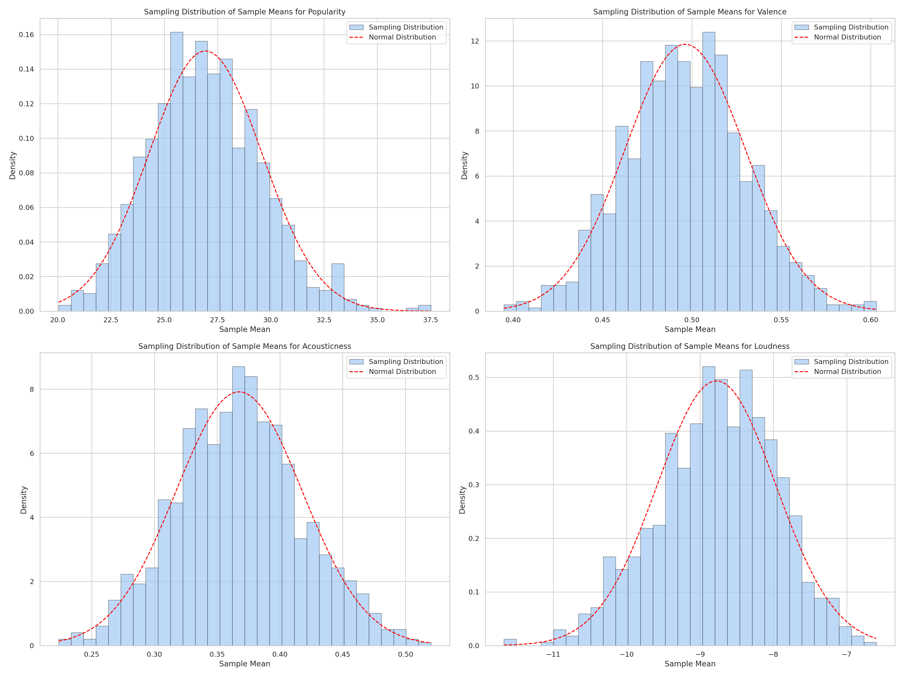
Sampling Distribution and CLT

Slide 14
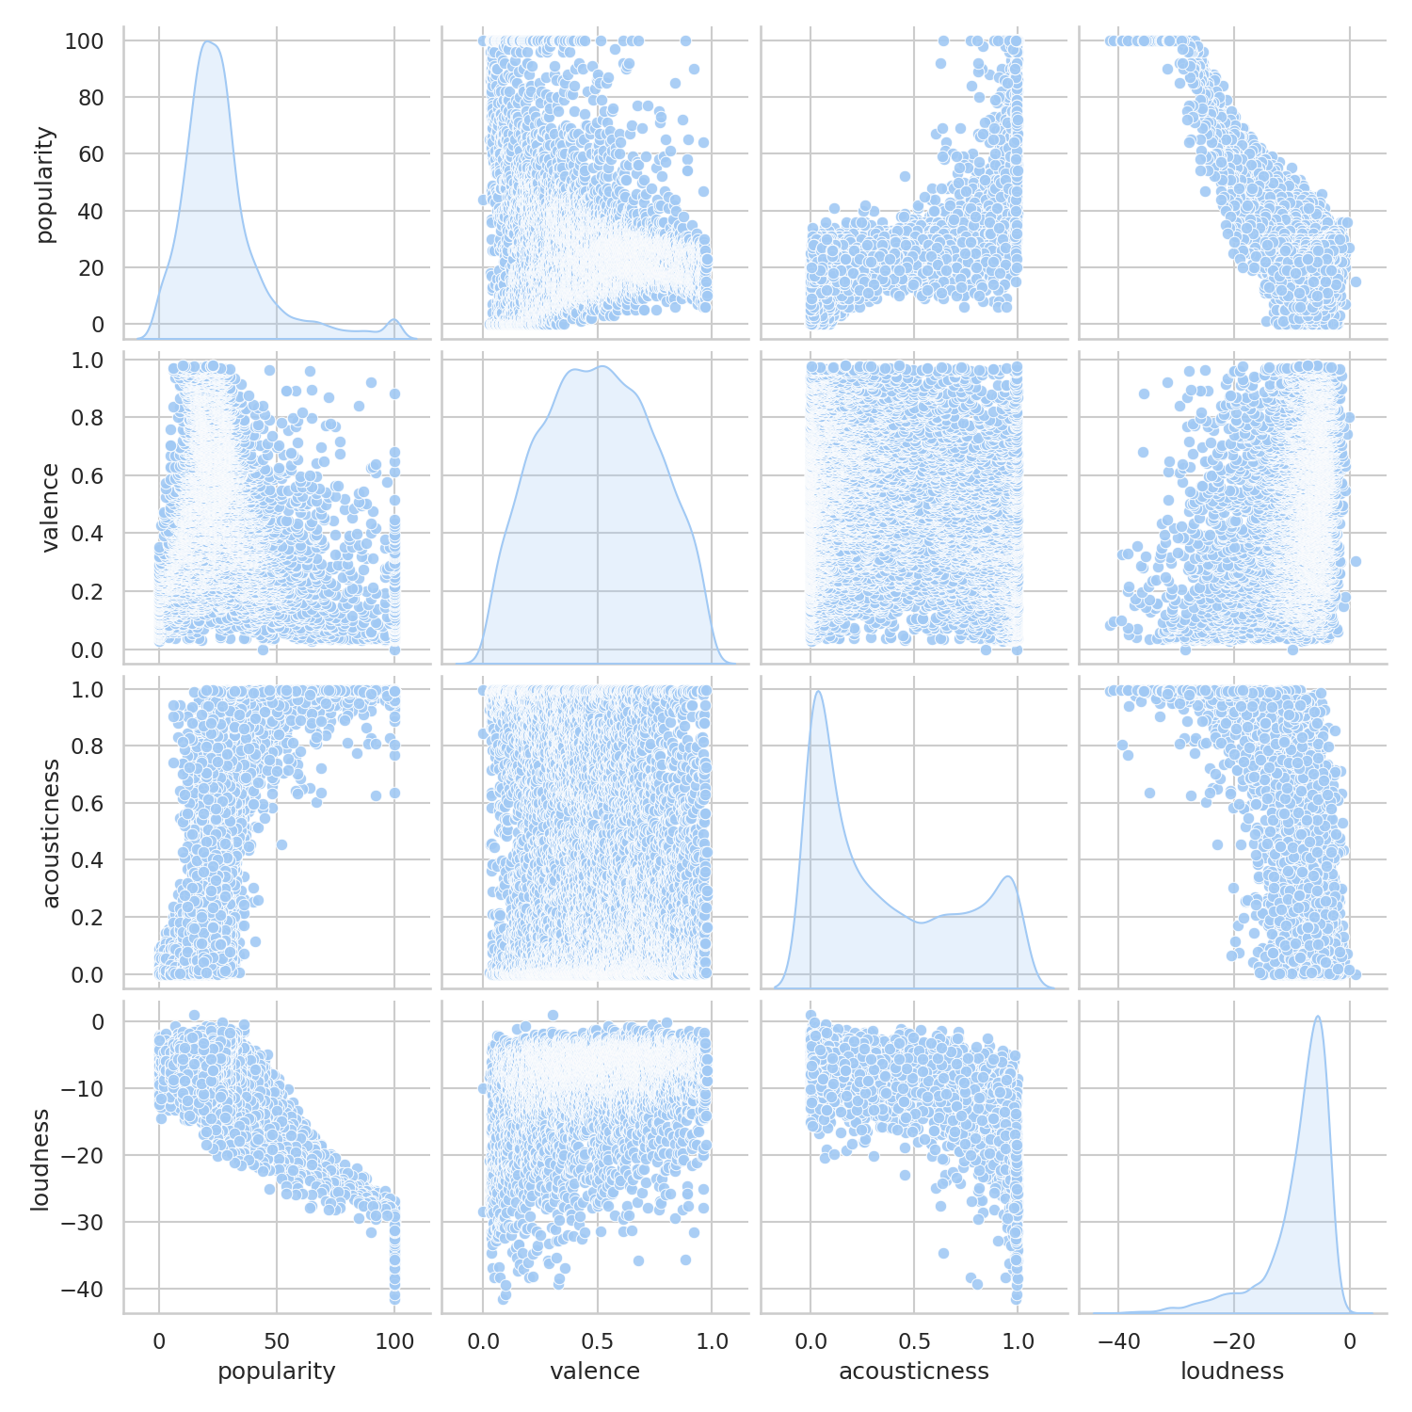
Inferential Analysis
Scatter Plot Insights
Popularity ↔ Acousticness: Positive correlation; more acoustic tracks tend to be more popular.
Popularity ↔ Loudness: Strong negative correlation; quieter tracks are more popular.
Popularity ↔ Valence: No significant correlation; scattered points with no trend.

Slide 15
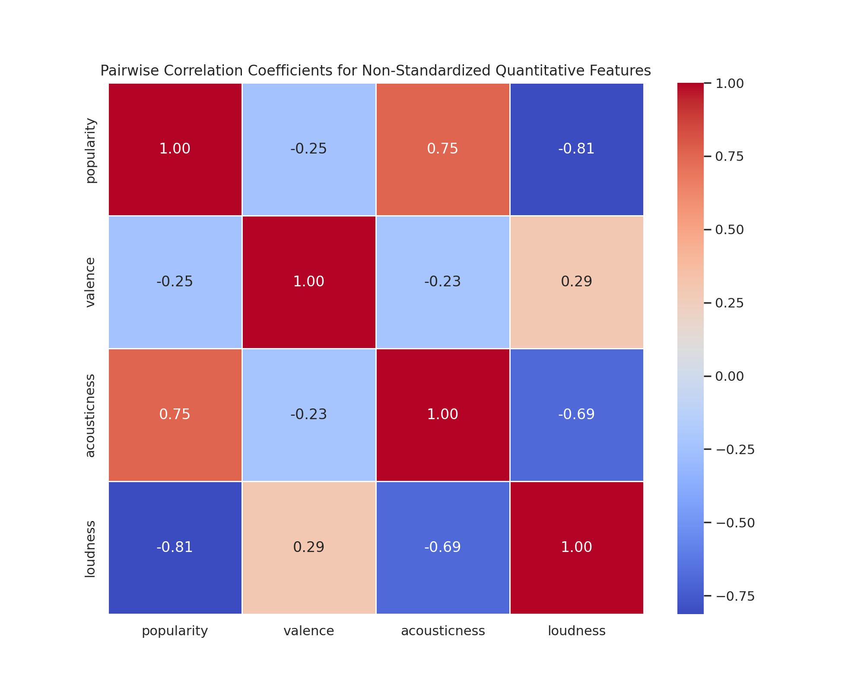
Inferential Analysis
Correlation Heatmap Insights
Acousticness & Popularity: Correlation coefficient = 0.75 (strong positive).
Loudness & Popularity: Correlation coefficient = -0.81 (strong negative).
Valence & Popularity: Weak or negligible correlation.

Slide 16
Hypothesis Testing
Test the relationships between popularity, genre, and explicitness using statistical methods.
Tests & Results
Genres:
Test: Kruskal-Wallis Test.
Result: the calculated H-statistic is 4245.986, and the p-value is 0.0.
Implication: indicates that Popularity varies with Genre.
Explicit Content:
Test: Mann-Whitney Test.
Result: the calculated R-statistic is 2980323.5, and the p-value is 0.0.
Implication: indicates that Popularity depends on whether the song is explicit.
Genre & Explicitness Dependency:
Test: Chi-Square Test.
Result: The degree of freedom df = 9 and the χ2 = 606.277 and the p-value comes out to be effectively 0.
Implication: indicates that Explicitness and Track Genre may be dependent as well

Slide 17
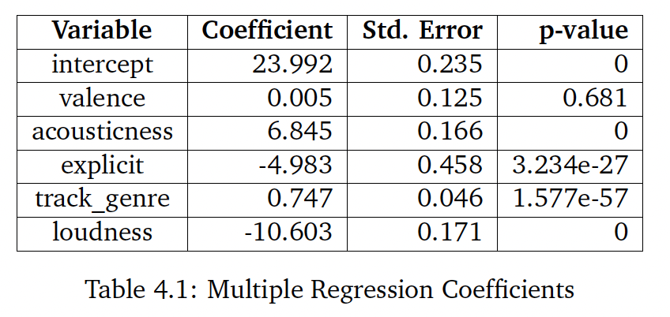
Regression Analysis
Predict track popularity using numerical and categorical features.
Multiple Linear Regression (MLR) Results
Significant Predictors:
Acousticness: Strong positive effect on popularity (+6.845 per unit increase).
Loudness: Strong negative effect on popularity (-10.603 per unit increase).
Explicitness: Negative impact (-4.983 for explicit tracks).
Insights:
Acoustic, quieter, and non-explicit tracks are more popular.
Valence has a negligible effect (non-significant p-value).
Model Performance:
R² = 0.768, Mean Squared Error (MSE) = 82.83.

Slide 18
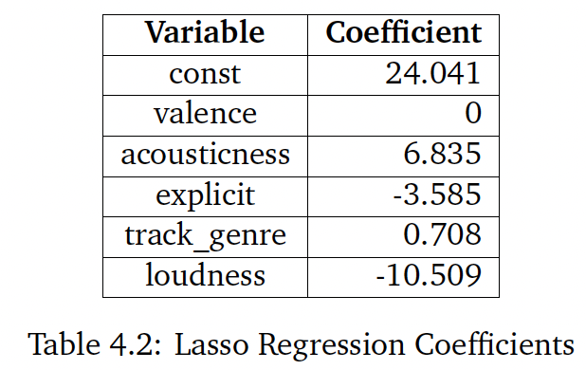
Lasso Regression
Key Features:
Shrinks coefficients of less relevant predictors to zero.
Helps improve model simplicity without compromising interpretability.
Results
Significant Predictors:
Acousticness: +6.835.
Loudness: -10.509.
Explicitness: -3.585.
Valence: Eliminated (coefficient = 0).
Insights:
Valence excluded as irrelevant.
Predictors have slightly smaller coefficients compared to Multiple Linear Regression due to regularization.
Model Performance:
R² = 0.767, MSE = 83.24 (similar to MLR).

Slide 19
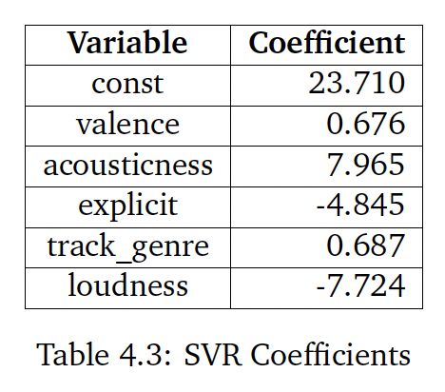
Support Vector Regression (SVR)
Captures complex relationships.
Less prone to overfitting compared to traditional linear models.
Results
Significant Predictors:
Acousticness: +7.965 (highest impact).
Loudness: -7.725.
Explicitness: -4.845.
Valence: Moderate positive impact (+0.676).
Insights:
Acousticness shows stronger influence in SVR compared to other models.
Explicit tracks remain less popular, consistent across all models.
Model Performance:
R² = 0.742, MSE = 92.33 (less accurate compared to MLR and Lasso).

Slide 20
Summary & Conclusion
Key Insights:
Popularity Drivers:
Non-explicit tracks with higher acousticness and lower loudness are more popular.
Significance of Features:
Genre and explicitness are critical categorical predictors.
Acousticness and loudness are the most impactful numerical features.
Model Performance:
Multiple Linear Regression and Lasso Regression performed best with similar accuracy (R² ~0.768).
Support Vector Regression captured additional complexities but had lower performance (R² = 0.742).
Implications:
Insights can guide artists, producers, and Spotify in optimizing track attributes and playlist curation

Slide 21
Thank You!

